Slide 1





Chlorination reactions
Solutions
A $\underset{→}{ k_{1} } R \underset{→}{ k_{4} }$ S
$$T$$
k₂
1) ${\left(\frac{C_{R}}{C_{Ao}}\right)}_{max}$= 0,072
k₅
2) $\left(\frac{C_{R}}{C_{T}}\right)$ = 0,80
B
k₃
3)${\left(\frac{C_{R}}{C_{Ao}−C_{A}}\right)}_{max}$= ---
First order reactions
k₁ = 3; k₂ = 1; k₃ = 1; k₄ = 20; k₅ = 8
C_{Ao} = 2C_{Bo} ; excess of chlorine
CSTR
Constant density
${\left(\frac{C_{R}}{C_{Ao}}\right)}_{max}?, \left(\frac{C_{R}}{C_{T}}\right)$ ?, $\left(\frac{C_{R}}{C_{Ao}−C_{A}}\right)?, {\left(\frac{C_{R}}{C_{Ao}−C_{A}}\right)}_{max}$ ?,

Slide 2

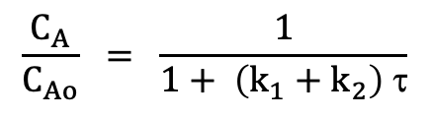

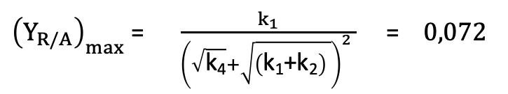
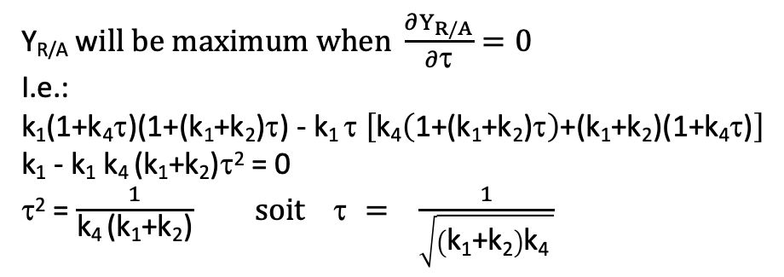
Chlorination reactions
A $\underset{→}{ k_{1} } R \underset{→}{ k_{4} }$ S
$$T$$
k₂
k₅
B
k₃
Mass balance on A in a CSTR
Q C_{Ao} - k₁ C_{A} V - k₂ C_{A} V = Q C_{A}
Inlet flow Chemical Outlet flow
rate of A production of A rate of A
$$\frac{C_{A}}{C_{Ao}} = \frac{1}{1+ \left(k_{1}+k_{2}\right) \text{t}}$$
Y_{R/A} w$ill be maximum when \frac{∂Y_{R/A}}{∂\text{t}}=0$
I.e.:
k₁(1+k₄$\text{t}\text{)(1+}$(k₁+k₂)$\text{t}$) - k₁ $\text{t}$ $\left[\text{k}\text{4}\left(\text{1+}\text{(}\text{k}\text{1}\text{+}\text{k}\text{2}\text{)}\text{t}\right)\text{+}\text{(}\text{k}\text{1}\text{+}\text{k}\text{2}\text{)(1+}\text{k}\text{4}\text{t}\text{)}\right]$
k₁ - k₁ $\text{k}\text{4 }\text{(}\text{k}\text{1}\text{+}\text{k}\text{2}\text{)}\text{t}$² = 0
$\text{t}$² = $\frac{1}{\text{k}\text{4} \text{(}\text{k}\text{1}\text{+}\text{k}\text{2}\text{)}} soit \text{t} = \frac{1}{\sqrt{\left(\text{k}\text{1}\text{+}\text{k}\text{2}\right)\text{k}\text{4 }}}$
Mass balance on R in a CSTR
0 + k₁ C_{A} V - k₄ C_{R} V = Q C_{R}
Y_{R/A} = $\frac{C_{R}}{C_{Ao}}= \frac{k_{1}\text{t}}{\left(1+k_{4}\text{t}\right) \left(1+ \left(k_{1}+k_{2}\right)\text{t}\right)}$
${\left(Y_{R/A}\right)}_{max}$= $\frac{k_{1}}{{\left(\sqrt{\text{k}\text{4}}+\sqrt{\left(\text{k}\text{1}\text{+}\text{k}\text{2}\right) }\right)}^{2} }$ = $0,072$

Slide 3
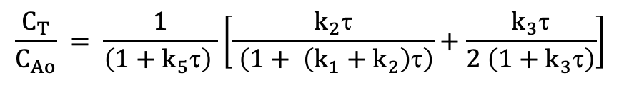
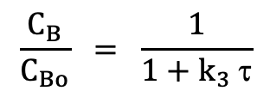

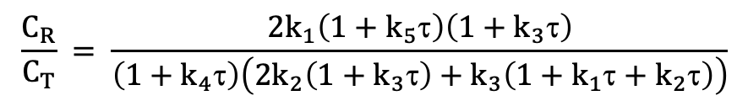
Chlorination reactions
A $\underset{→}{ k_{1} } R \underset{→}{ k_{4} }$ S
$$T$$
k₂
k₅
B
k₃
Mass balance on B in a CSTR
Q C_{Bo} - k₃ C_{B} V = Q C_{B}
$$\frac{C_{R}}{C_{T}} = \frac{2k_{1}\left(1+k_{5}\text{t}\right)\left(1+k_{3}\text{t}\right)}{\left(1+k_{4}\text{t}\right)\left(2k_{2}\left(1+k_{3}\text{t}\right)+k_{3}\left(1+k_{1}\text{t}+k_{2}\text{t}\right)\right)}$$
$$\frac{C_{B}}{C_{Bo}} = \frac{1}{1+k_{3} \text{t}}$$
$\frac{C_{R}}{C_{T}} =$0,8
Mass balance on T in a CSTR
0 + k₂ C_{A} V + k₃ C_{B} V - k₅ C_{T} V = Q C_{T}
k₂ C_{A} τ + k₃ C_{B} τ = (1+k₅τ)C_{T}
$$\frac{C_{T}}{C_{Ao}} = \frac{1}{\left(1+k_{5}\text{t}\right) }\left[\frac{k_{2}\text{t}}{ \left(1+ \left(k_{1}+k_{2}\right)\text{t}\right)}+\frac{k_{3}\text{t}}{2 \left(1+k_{3}\text{t}\right)}\right]$$

Slide 4
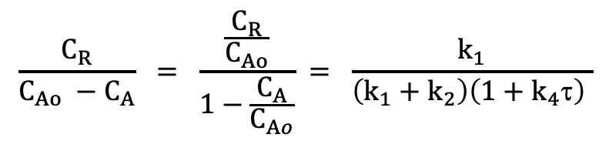
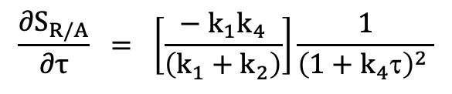
Chlorination reactions
A $\underset{→}{ k_{1} } R \underset{→}{ k_{4} }$ S
$$T$$
k₂
k₅
B
k₃
$$\frac{C_{R}}{C_{Ao} −C_{A}} = \frac{\frac{C_{R}}{C_{Ao}}}{1−\frac{C_{A}}{C_{Ao}}} = \frac{k_{1}}{\left(k_{1}+k_{2}\right)\left(1+k_{4}\text{t}\right) }$$
$$\frac{{∂S}_{R/A}}{∂τ} = \left[\frac{− k_{1}k_{4}}{\left(k_{1}+k_{2}\right)}\right]\frac{1}{{\left(1+k_{4}\text{t}\right)}^{2} }$$
La sélectivité en R par rapport à la quantité de A transformée décroit uniformément au cours du temps

